Slide 2
Gospel | The Evangelist | Approximate Date Written | Location Where Written | Audience | Image of Jesus & Examples | Genealogy (if any)
Matthew
Mark | Unknown… John Mark (a friend of Paul) a Gentile Christian (might be a disciple of Peter) | AD 65-AD 70 30 yrs after Jesus’ Resurrection & Ascension into Heaven b4 & during the fall of Jerusalem & the Temple Roman Emperor: Nero = lots of Christian persecution & martyrdom | probably Rome | Gentile Christians-references the OT since the audience didn’t know about the Scriptures | un-recognized, suffering, serving Messiah | none- Jesus is a servant & servants didn’t have genealogies @ this time
Luke
John

Slide 3
Gospel | The Evangelist | Approximate Date Written | Location Where Written | Audience | Image of Jesus & Examples | Genealogy (if any)
Matthew | Unknown… the apostle/tax collector 2nd generation Jewish Christian of Palestinian origin | AD 70-AD 85 (appears 1st in the NT b/c originally believed to be written 1st) | Antioch (Syria) (Fun Fact: 1st place where followers of JC are called Christians) | Jewish Christians | Teaching Savior | Traced back to Abraham

Slide 4
A Synoptic Gospel: Matthew’s References
The Gospel According to Mark
Q
principally the sayings of Jesus
not found in Mark
(NOTE: Luke also draws information from this source)
M
unique material found in this Gospel ONLY

Slide 5
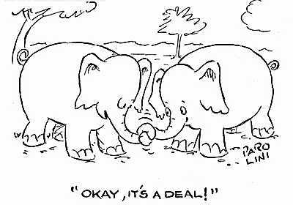
Covenant
an agreement b/w 2 parties that have come to terms

Slide 6
JESUS as the Fulfillment of the Covenant
 | OT | NT
THE PEOPLE
SLAVES TO…
SAVED BY…
CROSSED WATERS OF…
CELEBRATED BY…
LAW

Slide 7
JESUS as the Fulfillment of the Covenant
 | OT | NT
THE PEOPLE | Israelites | Followers of Jesus
SLAVES TO… | The Egyptians | Sin
SAVED BY… | The Blood of the Lamb | Jesus, the Lamb of God
CROSSED WATERS OF… | The Red Sea | Baptism
CELEBRATED BY… | The Passover Meal | The Eucharist
LAW | The 10 Commandments | The Law of Love

Slide 8
Partners: Old Testament Prophecies Cited in the Matthew
Directions:
Read the Scripture passage from the Old Testament, and then determine the prophecy being made about the life of Jesus Christ. Write the prophecy under the What is the prophecy? column.
After an attempt has been made for each, copy the Scripture passages of The Gospel According to Matthew from the projected screen.
Re-read the Scripture passage from the Old Testament and read the Scripture passages of The Gospel According to Matthew. Determine The Prophecy being made.
Answer the question on the reverse side of the sheet.

Slide 9
Old Testament | What is the prophecy? | The Gospel According to Matthew | The Prophecy
Micah 5:1-2 |  | 2:1
Hosea 11:1 |  | 2:13-14
Jeremiah 31:15 |  | 2:16
Isaiah 40:3-5 |  | 3:1-2
Isaiah 42:1-4 |  | 12:15-16
Isaiah 53:4 |  | 8:16
Psalm 78:2 |  | 13:34
Isaiah 6:9-10 |  | 13:10-13
Zechariah 9:9 |  | 21:1-11
Zechariah 13:7 |  | 26:31
Zechariah 11:12-13 |  | 27:3-10
Psalm 110:1 |  | 22:41-46

Slide 10
ANY QUESTIONS?

Slide 11
Jesus’ Family Tree
traced to Abraham
proved relation to Israel
5 women are mentioned…
Tamar (Gentile)
Rahab (Gentile)
Ruth (Gentile)
wife of Uriah
Bathsheba (Gentile)
Mary (Jew)
JC came from both
Jews & Gentiles!

Slide 12
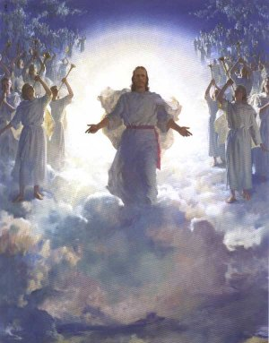
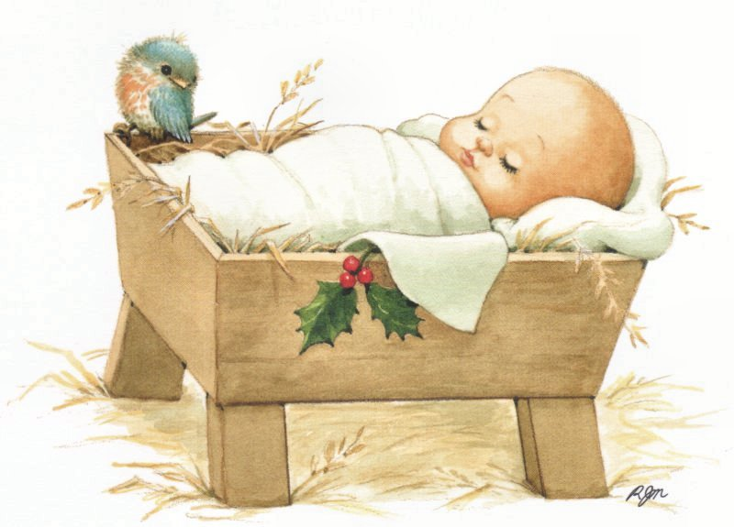
Jesus is The Fulfillment Of God’s Plan
Matthew begins w/ Jesus’ birth
shows the fulfilled of OT’s messianic prophecies
merged Jewish tradition with the new life of Jesus
emphasized Jesus as the long-awaited Messiah

Slide 13
IT’S A BOY!
Gabriel announces JC’s conception
thru the Holy Spirit
Jesus = “God Saves”
even at his birth…
some would accept JC…
visitation of angels, shepherds, & Magi
some would not…
Herod

Slide 14
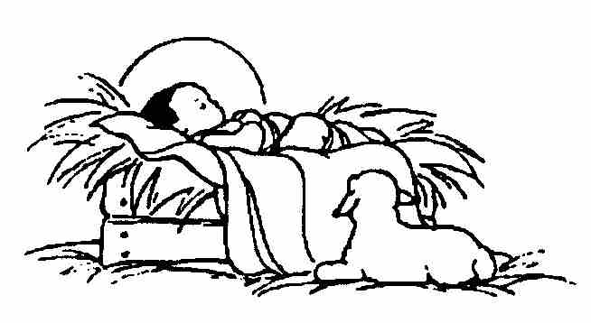
Jesus: 100% Human, 100% Divine
The Incarnation
to become flesh or to take on a human body
Jesus, the Son of God, becomes man
why?
to restore our relationship w/ God
to help us understand God’s love
to set an example for us
to experience our own divinity
the sacraments

Slide 15
ANY QUESTIONS?

Slide 16
The Temptation of Jesus (Matthew 4:1-11)
Jesus tempted 3 times by the devil…
1st temptation: material power
2nd temptation: miraculous power
3rd temptation: political power

Slide 17
SIN
a thought, word, or deed that contradicts God’s law
turning away from God & choosing to do what we know is against His will
ALL sin affects a person’s relationship w/ God
our faith in GOD gives us
the power to fight temptation & sin!

Slide 18
Reflection: Solutions to Temptations
What are the “not-so-good” temptations in your life? (You may simply list your temptations.)
How do you overcome those temptations?

Slide 19
The Ultimate End
Heaven
a state of living in eternal happiness w/ God
how to get “there”:
make good choices
seek forgiveness if a bad choice is made
try to lead a life reflective of JC
Purgatory
the state of purification b/w death & eternal life
a waiting room
a time to be forgiven for sins not confessed before death
the living can help through prayer!
Hell
eternal separation from God
how to get “there”:
choose not to accept God

Slide 20
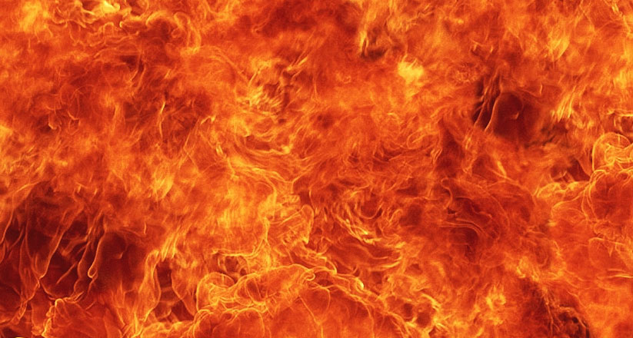
Reflection: Personal Heaven & Hell
Describe your interpretation of Heaven.
Describe your interpretation of
Hell.

Slide 21
ANY QUESTIONS?

