Slide 1
Persecution
not everyone was a fan of Jesus…

Slide 2
Jewish Groups @ the Time of Jesus
Pharisees
well-educated religious leaders mainly concerned with keeping Jews faithful to the strict interpretation of the Law
Sadducees
aristocratic ruling class, chief priests (The Sanhedrin) & elders of the community, believing in nothing else besides the Torah
Scribes
interpreted & taught the Law
Zealots
a rebellious group of militant Jews who viewed foreigners blasphemous against God

Slide 3
Persecution by the Romans
originally, the Romans did NOT have any problems with the Jews or Jewish Christians until…
…Christian beliefs came in direct conflict with the purpose of the emperor
Christianity rejected the worship of the emperor & the Roman gods
accused Christians for the gods’ unhappiness
plagues, invasions, earthquakes, etc.
3 of the worst emperors who persecuted Christians were…

Slide 4
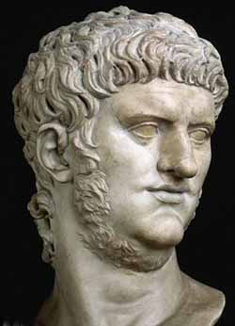
Nero
July 19th, 64AD, set fire to Rome b/c he wanted to rebuild the city
OBVIOUSLY, the Romans were not too happy when their city went up in smoke…so…
blamed the fire on the Christians & their God
notable deaths under Nero
Peter dies in 64AD
Paul dies in 67AD

Slide 5
Domitian
a Roman emperor who targeted “atheists”
Domitian’s definition: those who did not worship him as Dominus et Deus (“lord & god”)
today’s definition: the denial of God’s existence
the punishment
a special tax
death

Slide 6
Diocletian
came to the throne at 284 and divided the Roman empire into “dioceses”
The Great Persecution
reinstated emperor worship for all citizens
confiscated the property of Christians
destroyed churches & sacred books
banished them to hard labor
subjected them to a host of tortures
death penalty

Slide 7
Reflection: What would you do?
apostasy
the sin of denying one’s faith to avoid being killed
example ☺

Slide 8
ANY QUESTIONS?

Slide 9
How did we make it?
Jewish Diaspora
exile forced Jews to settle all over Europe
spreading of people=spreading of God’s Word
easy travel & communication
the Pax Romana
although compliancy occurred, people were not afraid to be Christian
possibility of death was no more
a powerful spiritual message backed by powerful action
Jesus…US!
“…if this endeavor or this activity is of human origin, it will destroy itself. But if it comes from God, you will not be able to destroy them; you may even find yourself fighting against God.”
Acts 5:38-39

Slide 10
Constantine & Religious Tolerance The Christian Emperor
named himself Pontifex Maximus
“the greatest bridge-builder”
bridging the gap b/w human & divine
adopted by popes…pontiff
The Edict of Milan
declaration allowing religious freedom in the Roman Empire in 313
NOT declaring Christianity as the empire’s official religion
was baptized in 337 on his death bed

Slide 11
ANY QUESTIONS?

Slide 12
Heresy
a belief, attitude, or teaching that is contrary to revealed truth, and to the Church’s doctrine of faith
the opposite: orthodoxy
a doctrine, belief, attitude, or teaching that is consistent with revealed truth & with the Church’s doctrine of faith

Slide 13
Arianism
Argument/Proposition-
only God the Father was immortal
proclaimed the Father, the Son, and the Holy Spirit were separate and distinct
Difficulty Raised-
the central Christian belief: God is one divine substance but 3 distinct Persons
Resolution By The Church-
doctrine of consubstantiality
God the Father, God the Son, and God the Holy Spirit are of one Being
When/Where/By Whom It Was Resolved-
325 Constantine opens the Council of Nicaea
1st ecumenical council
world-wide gathering of Catholic bishops
over 300 bishops attended
formulate a creed: The Nicene Creed

Slide 14
ANY QUESTIONS?

Slide 15
Defending the Faith: Apologists
2nd-century writers who defended and explained Christianity to nonbelievers
example:
Justin Martyr
tried to explain to Jews that JC fulfilled the OT prophecies about the Messiah
tried to convince pagans that Christianity makes sense

Slide 16
Fathers Of The Church
men who assisted Church members through their writings, teachings, and/or exemplary lives in deciding matters of Christian belief & practices

Slide 17
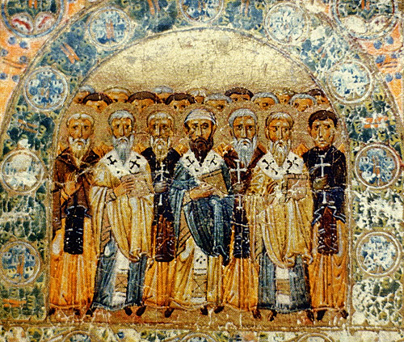
Fathers Of The Church
Alexander of Alexandria [SAINT]
Alexander of Lycopolis
Ambrose (340-397) [SAINT] [DOCTOR]
Aphrahat/Aphraates (c. 280-367)
Archelaus
Aristides the Philosopher
Arnobius
Athanasius [SAINT] [DOCTOR]
Athenagoras
Augustine of Hippo [SAINT] [DOCTOR]
Bardesanes (154-222)
Barnabas [SAINT]
Basil the Great [SAINT] [DOCTOR]
Caius
Clement of Alexandria [SAINT]
Clement of Rome [SAINT]
Commodianus
Cyprian of Carthage [SAINT]
Cyril of Jerusalem [SAINT] [DOCTOR]
Dionysius of Rome [SAINT]
Dionysius the Great
Ephraim the Syrian (306-373) [SAINT] [DOCTOR]
Eusebius of Caesarea (c. 265-c. 340)
Gennadius of Marseilles
Gregory the Great, Pope (c. 540-604) [SAINT] [DOCTOR]
Gregory Nazianzen [SAINT] [DOCTOR]
Gregory of Nyssa [SAINT]
Gregory Thaumaturgus [SAINT]
Hermas
Hilary of Poitiers [SAINT] [DOCTOR]
Hippolytus [SAINT]
Ignatius of Antioch [SAINT]
Irenaeus of Lyons [SAINT]
Jerome [SAINT] [DOCTOR]
John of Damascus [SAINT] [DOCTOR]
John Cassian (c. 360-c. 435)
John Chrysostom [SAINT] [DOCTOR]
Julius Africanus
Justin Martyr [SAINT]
Lactantius
Leo the Great, Pope (c. 395-461) [SAINT] [DOCTOR]
Malchion
Mar Jacob (452-521)
Mathetes
Methodius
Minucius Felix
Moses of Chorene (c. 400-c. 490)
Novatian
Origen
Pamphilus [SAINT]
Papias [SAINT]
Peter of Alexandria [SAINT]
Polycarp [SAINT]
Rufinus
Socrates Scholasticus (c. 379-c. 450)
Sozomen (c. 375-c. 447)
Sulpitius Severus (c. 363-c. 420)
Tatian
Tertullian
Theodoret
Theodotus
Theophilus
Venantius
Victorinus [SAINT]
Vincent of Lérins (d. c. 450) [SAINT]

Slide 18
ANY QUESTIONS?

